Slide 1

Sex Disparities in Mortality and Causes of Death in the Netherlands: An Exploration of Historical Amsterdam Data, 1856-1875
Gilbert Habaasa
Summer Project Presentation at CED, Barcelona, Spain, on Friday, 19 June 2026

Slide 2
Research Problem
What we know
Modern demography emphasises the female survival advantage over male counterparts: Females have had higher life expectancy than males for the last 100 years.
But Does Historical Data show a female-male survival advantage?
Is the female-male survival advantage uniformly present across all age groups and years in 19th-century Amsterdam, Netherlands(1856-1875)?
What explains the differences in female-male survival across ages and time in the 19th Century?

Slide 3
Data
Data
Amsterdam Cause of Death (ACD)
Amsterdam Population data [comparing age groups in the censuses and in the paper of Marco van Leeuwen]
Data description
year
month
age-year,
gender,
ICD10h1
Type of data
Amsterdam historical data (1856-1875).
Source of data
GREAT LEAP

Slide 4
Methodology
Analytical Techniques
Descriptive statistics
Distribution of death by gender
Multinomial logistic regression
Relative Risk Ratio for women vs men.
Decomposition analysis of mortality by Gender (Kitagawa, 1955 method).
Direct effect: variations in age-specific risks
Structure effect: shifts in population structure.

Slide 5
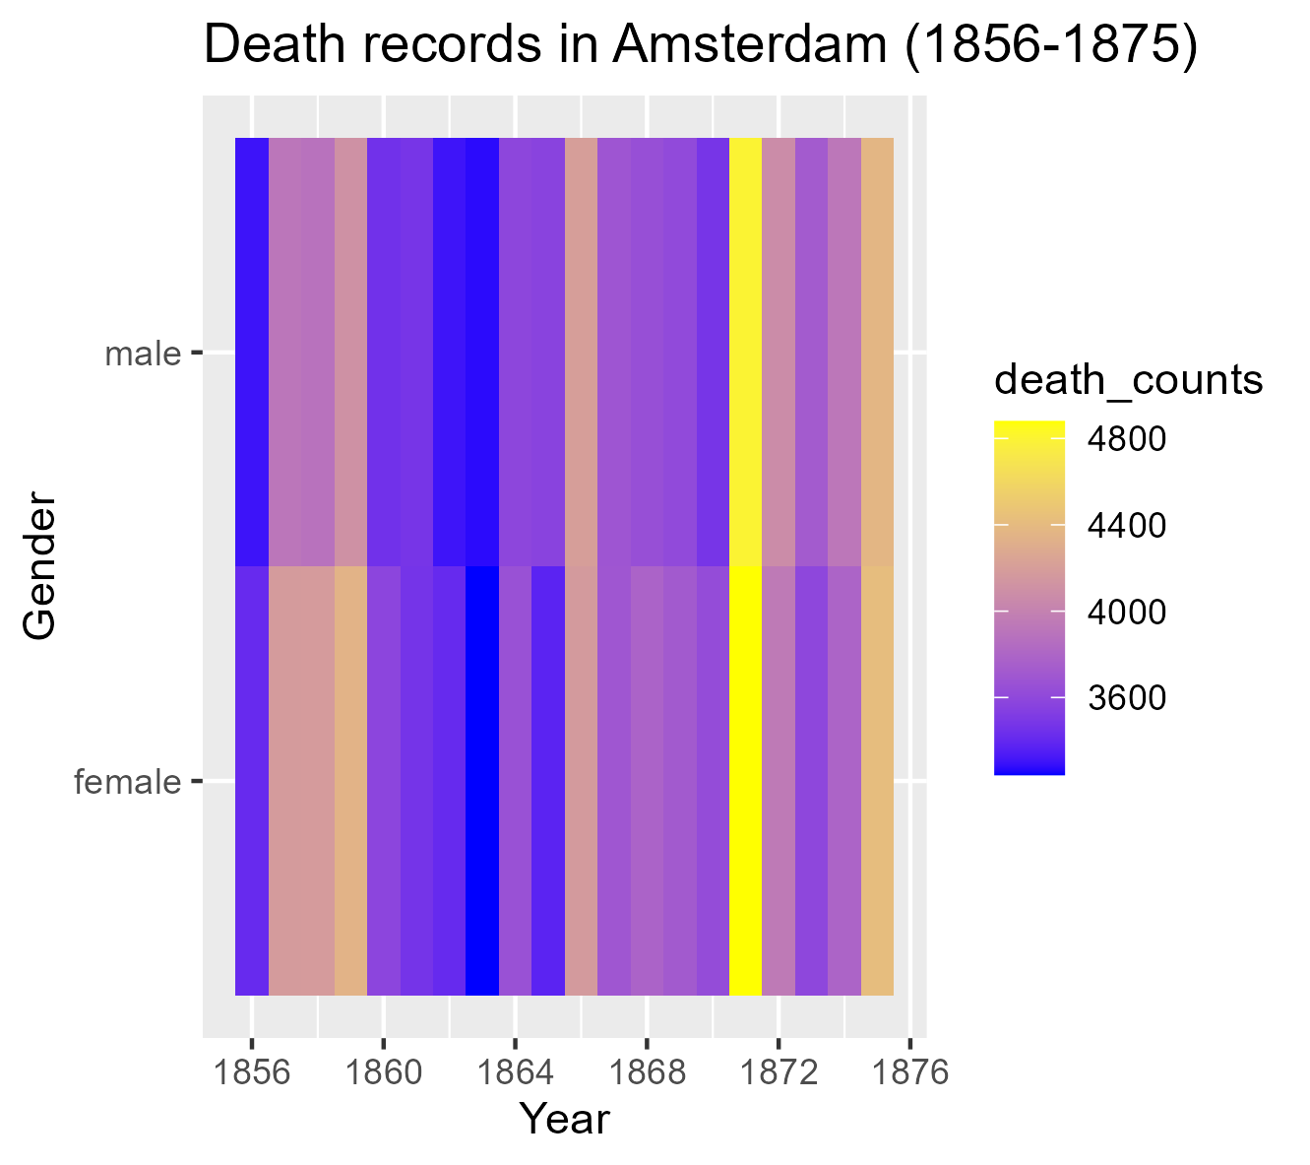
Main Results
The distribution of deaths is almost identical for both men and women.
A spike in deaths for both men and women (1871-1872) may be due to an epidemic.

Slide 6
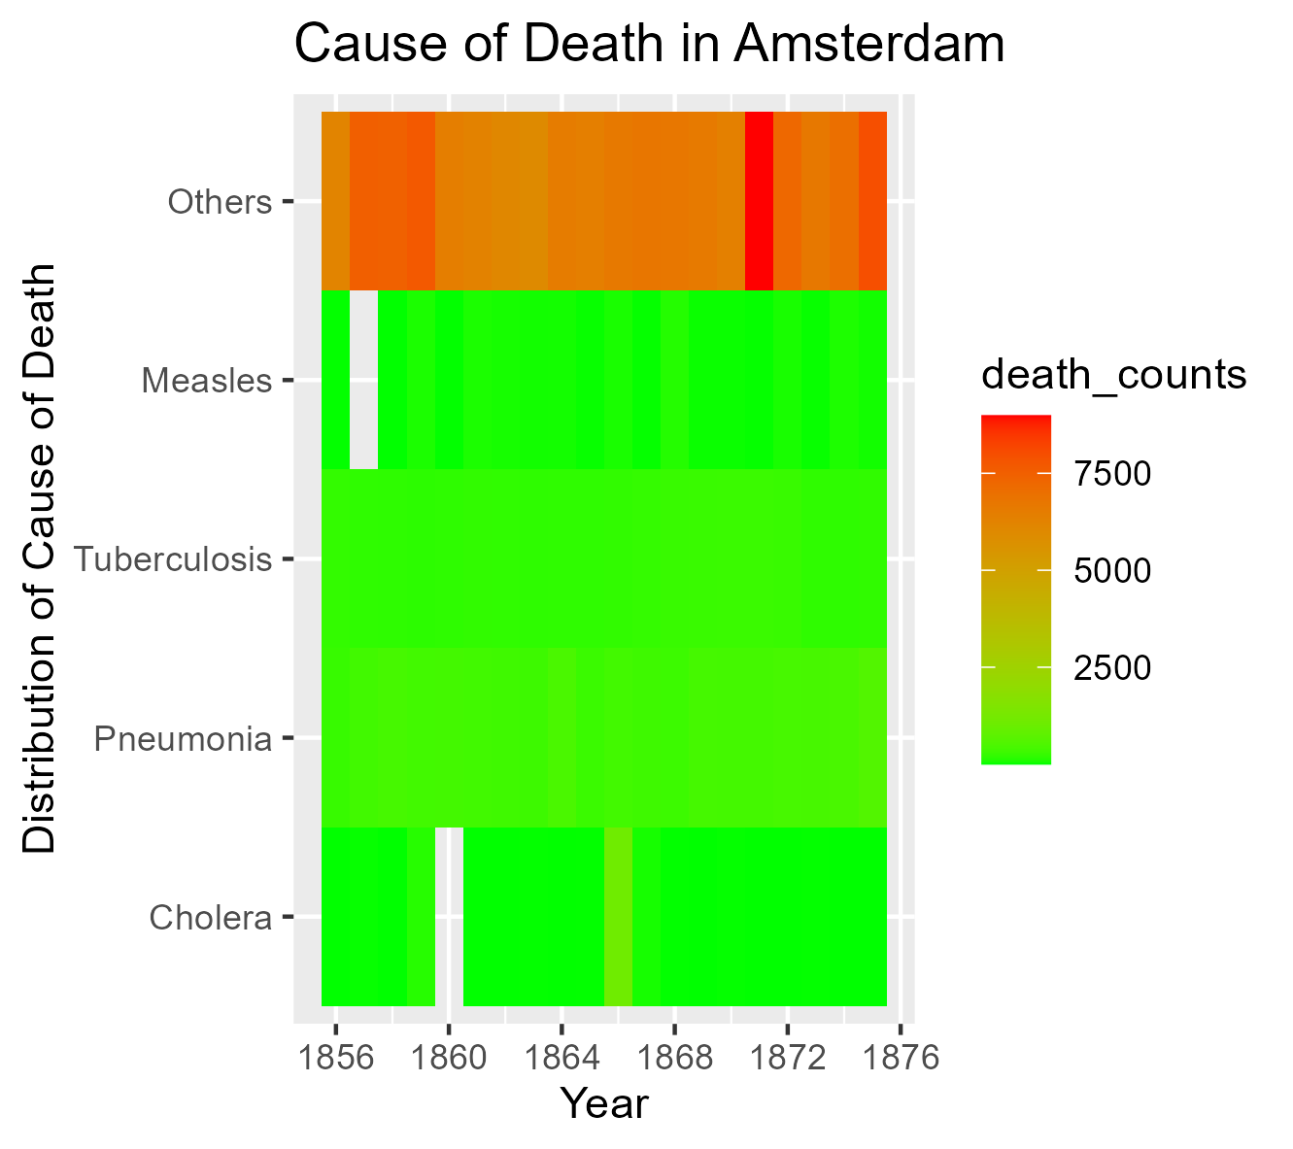
Causes of death in Amsterdam (1856-1875)
Other causes of death were dominant.
Epidemic spikes of Cholera and Measles (short spikes).

Slide 7
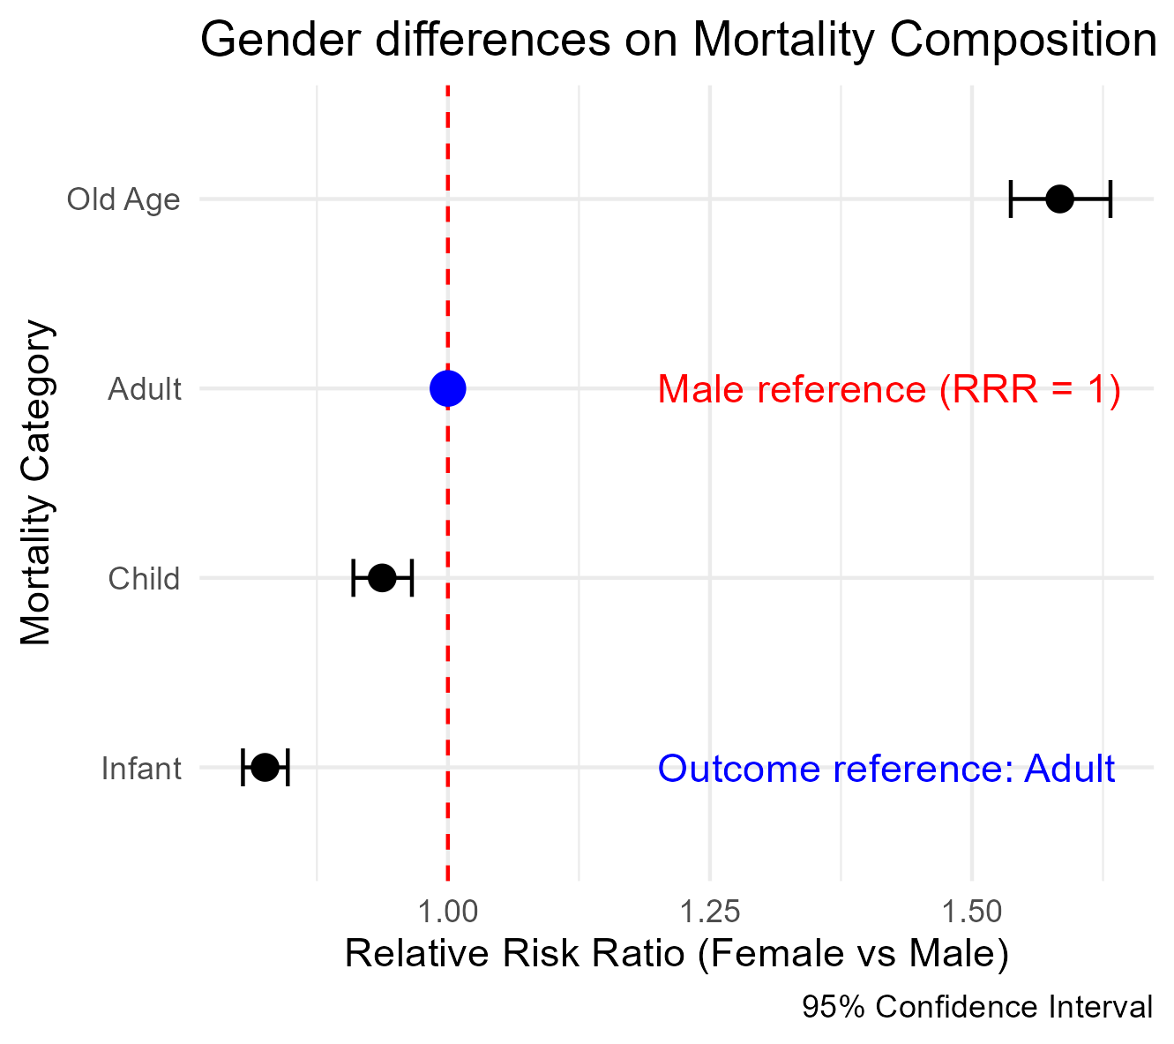
Multinomial Logistic Regression
Women exhibit a high survival advantage as infants and children compared to adults.
However, Women have a higher relative risk ratio at old age than at the adult stage.

Slide 8
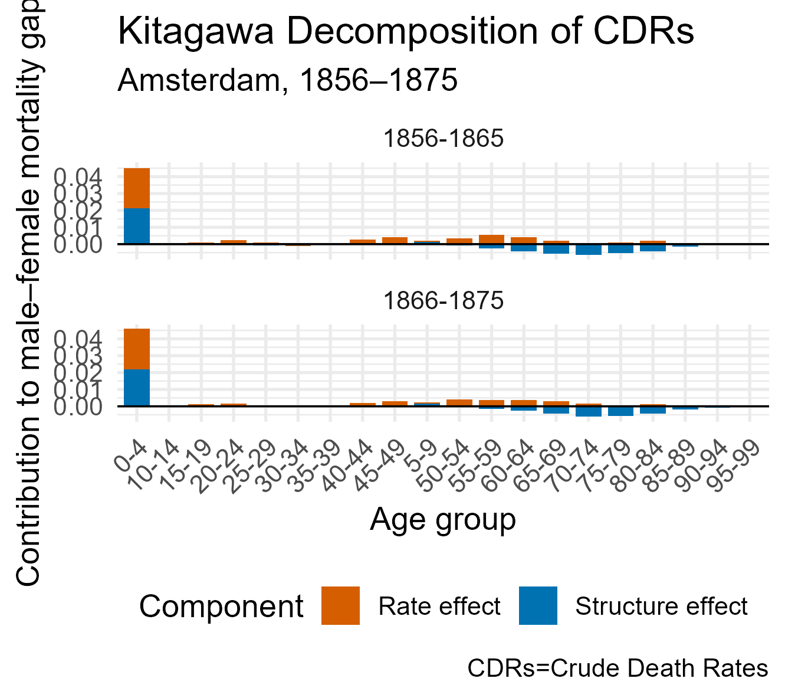
Decomposition of Gender Differences in Mortality
Mortality differences are largely driven by age-specific mortality differences rather than demographic composition.

Slide 9
Conclusions
The existence of a female advantage in the mid-19th century suggests that this pattern is not purely a modern phenomenon.
However, the dominance of infant and child mortality in the 19th century differs from the contemporary situation, where adult and older-age mortality plays a larger role in gender differences in mortality.
As a limitation, the study used the population estimates of 1869 and 1879 as a proxy population at risk. Also, the dataset comprised of only death records and no survivor records.

Slide 10
END
Thank you for your attention

